Slide 1




Design and Fabrication of a Robotic Knee Exoskeleton
By: Hannah Rentschler
mentor: Dr. Zachary Lerner
Northern Arizona University

Slide 2

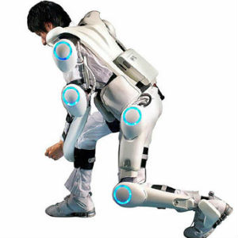
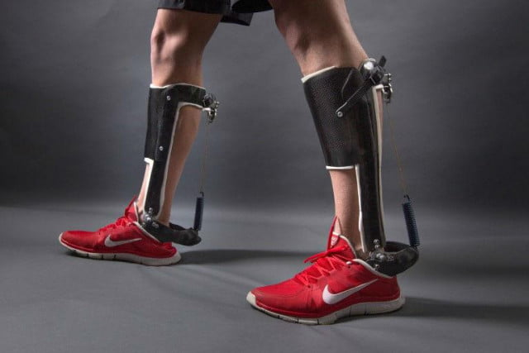
Introduction
Wearable robotic exoskeletons augment human joint motion
Exoskeletons can be passive or active
Can be single or multiple joint systems
https://www.nwf.org/Educational-Resources/Wildlife-Guide/Invertebrates/Blue-Crab
https://www.roboticsbusinessreview.com/health-medical/exoskeleton_startup_cyberdyne_surges_in_trading_debut
https://newatlas.com/unpowered-ankle-exoskeleton-walking-efficiency/36847/

Slide 3
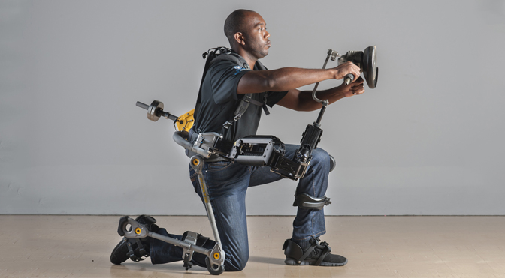
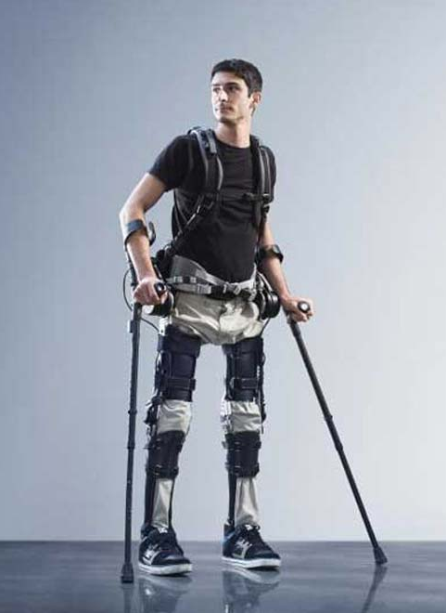
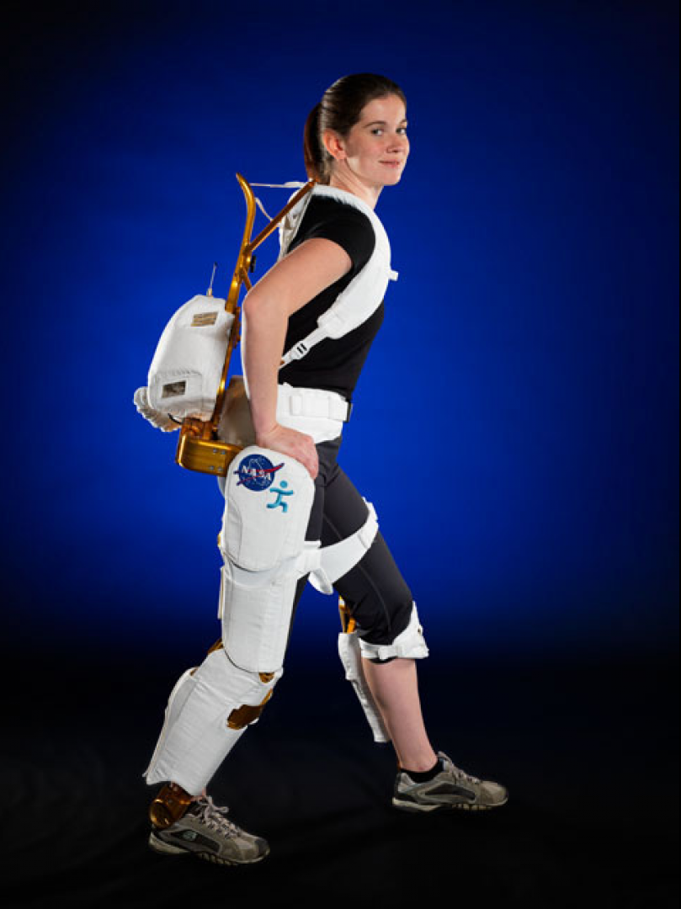
Introduction
Applications:
  Work environments
  Military use
  Restoring loss of mobility
  Space environments
  Physical Therapy
https://www.extremetech.com/extreme/191959-the-fortis-exoskeleton-let-you-lift-heavy-tools-indefinitely-and-its-unpowered
https://www.nasa.gov/offices/oct/home/feature_exoskeleton.html
https://gizmodo.com/i-understand-this-is-an-early-version-but-i-can-see-one-1756999672

Slide 4
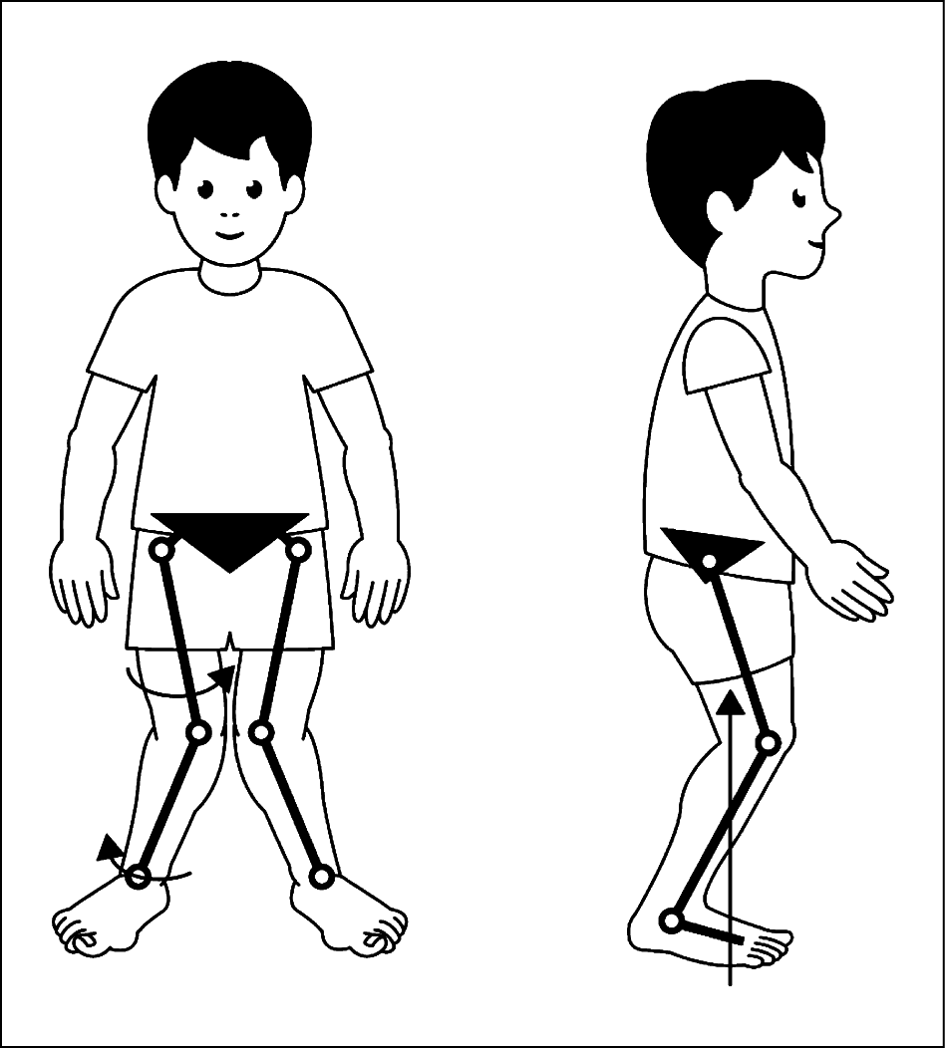
Project Focus
Cerebral palsy
  Often results in motor impairments
  Reduce mobility and stability
  Increase the energy cost of transport
Crouch gait
  Excessive knee flexion
  Can lead to knee pain and degradation
https://jamanetwork.com/journals/jamaneurology/fullarticle/1151825

Slide 5
Project Focus
Cerebral palsy
  Often results in motor impairments
  Reduce mobility and stability
  Increase the energy cost of transport
Crouch gait
  Excessive knee flexion
  Can lead to knee pain and degradation
https://jamanetwork.com/journals/jamaneurology/fullarticle/1151825
Need a way to extend the knee during walking

Slide 6
Project Goals
To provide resistance/assistance about the knee joint
To design, build, assemble, and test a knee exoskeleton:
  Compact/light weight
  Incorporate sensor to retrieve knee flexion
  Customizable orthotics

Slide 7
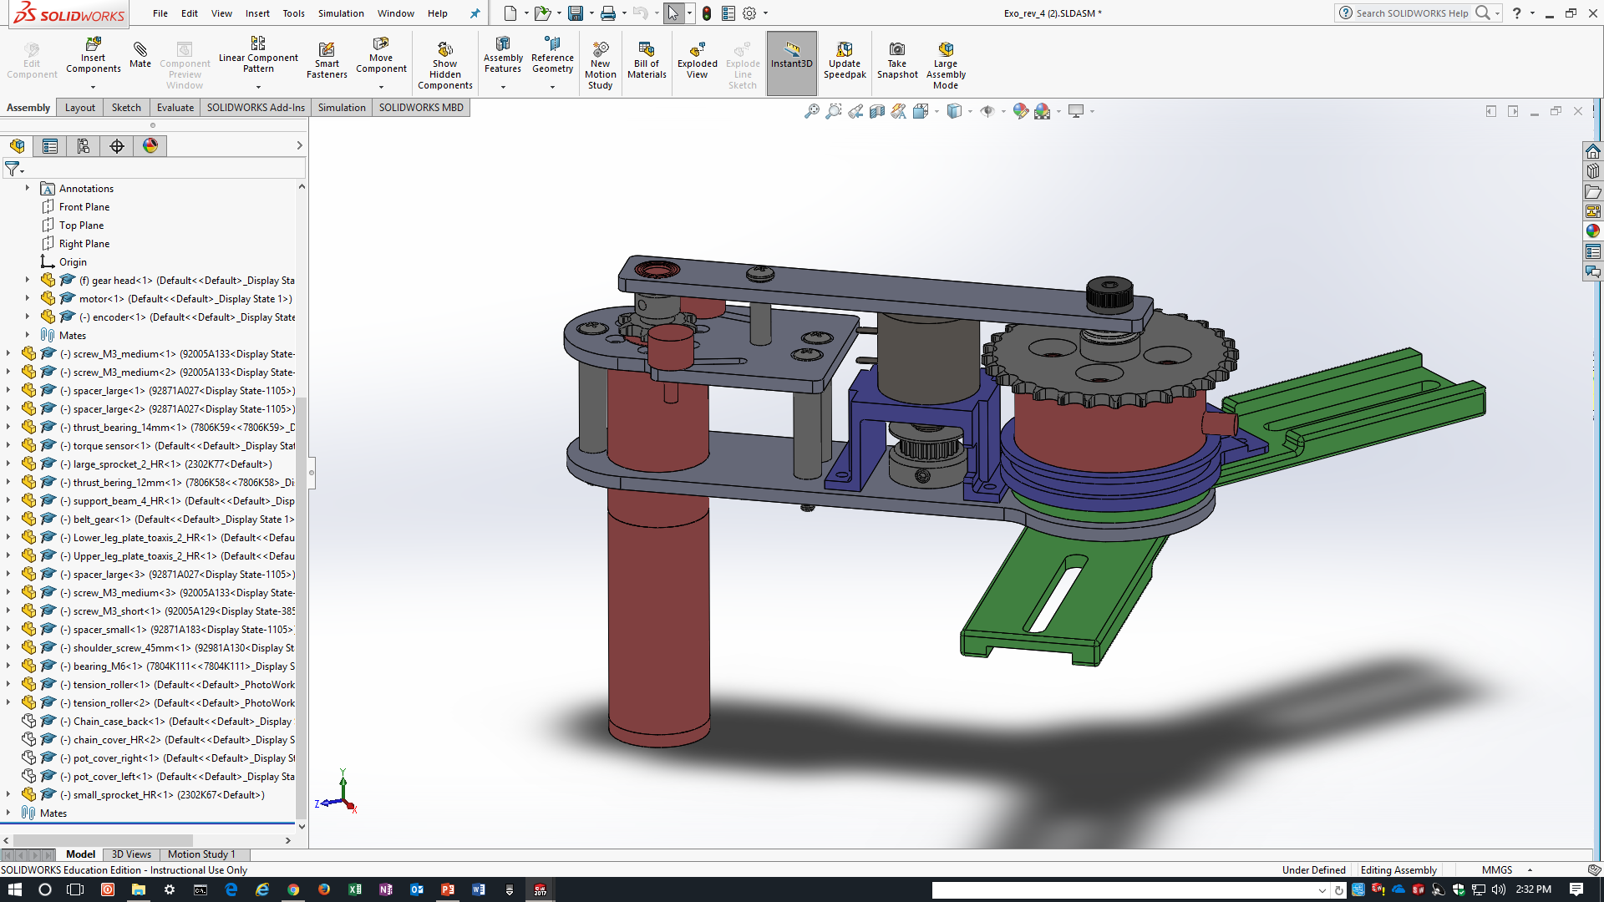
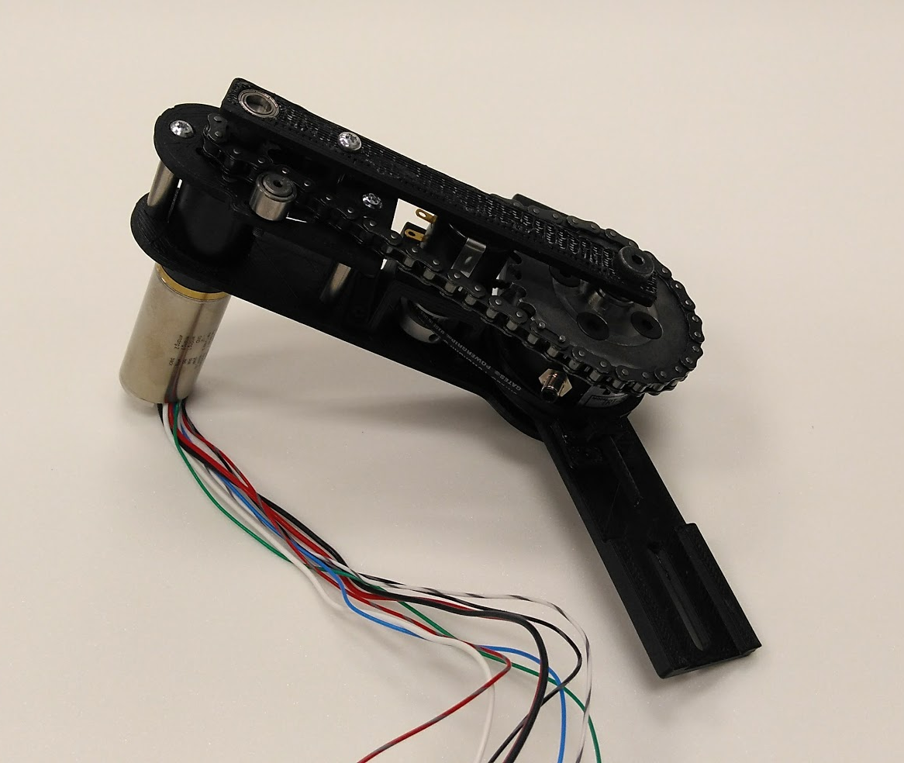
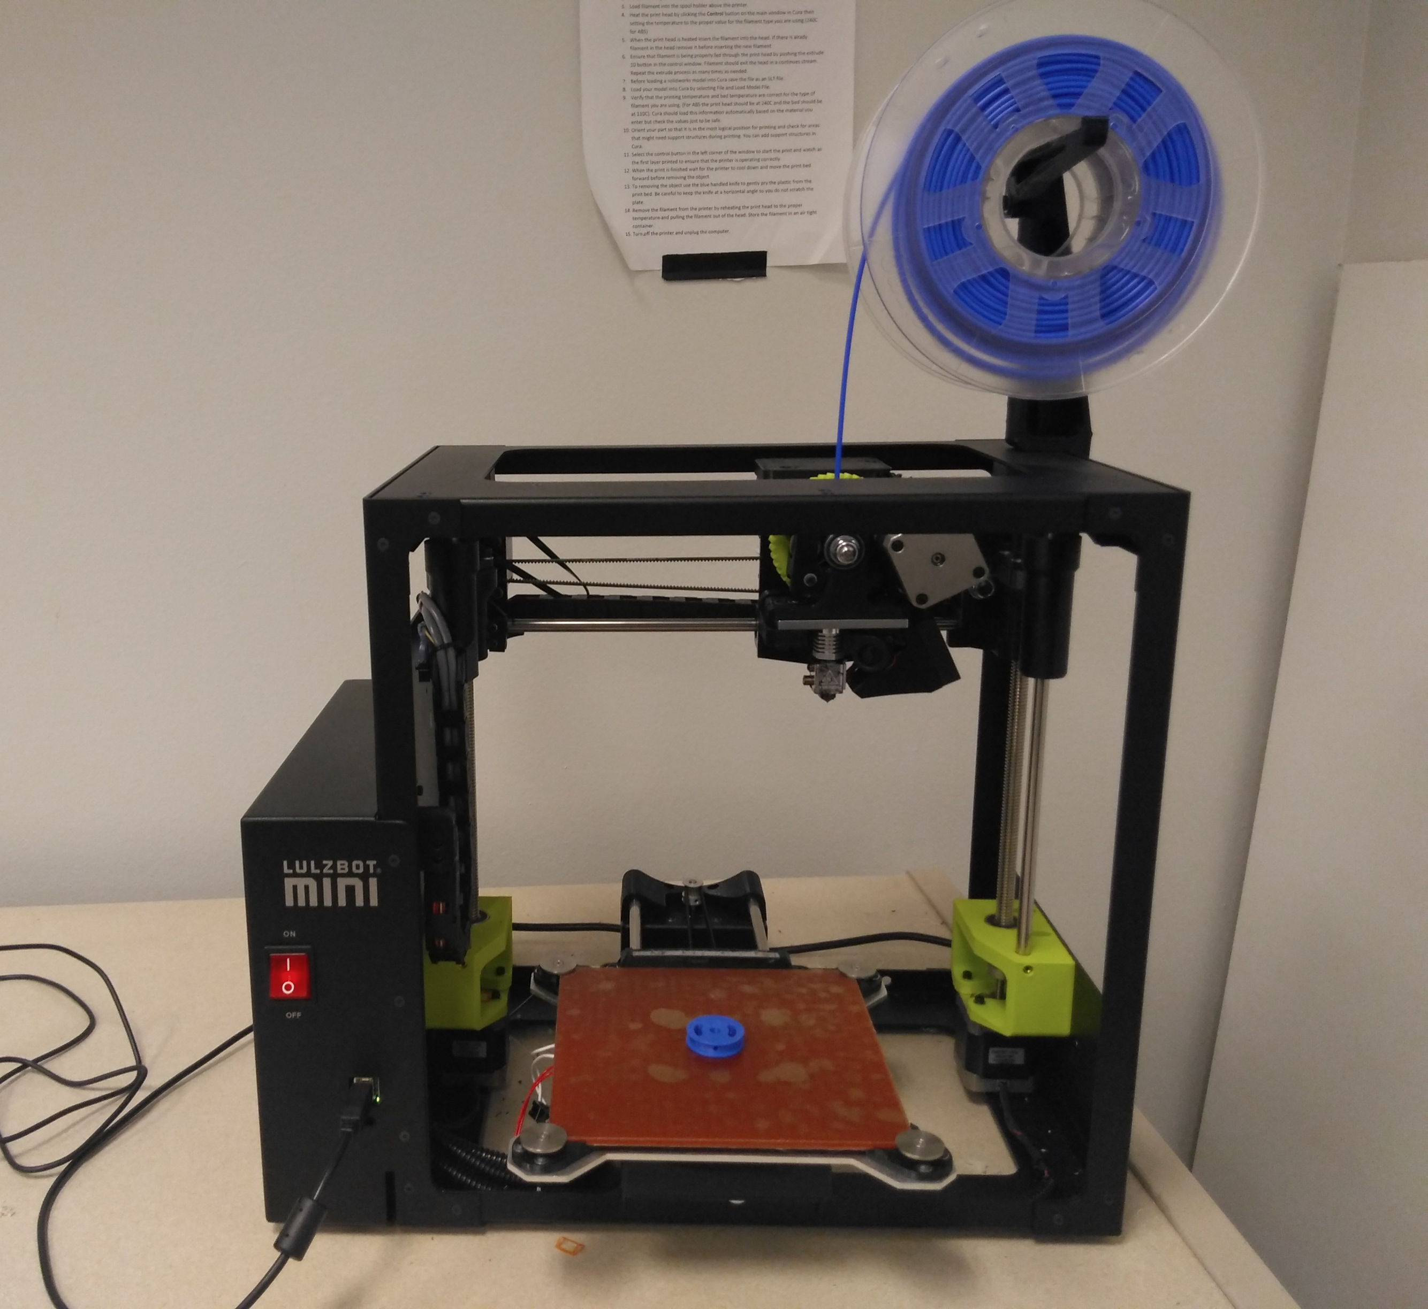
Methods
SolidWorks
Rapid prototyping using 3D printing
Lulzbot Mini

Slide 8
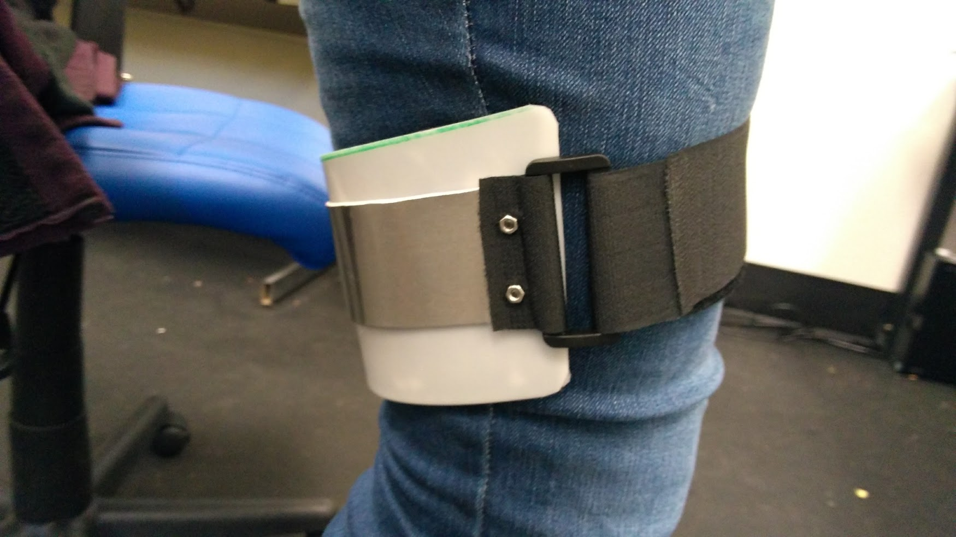
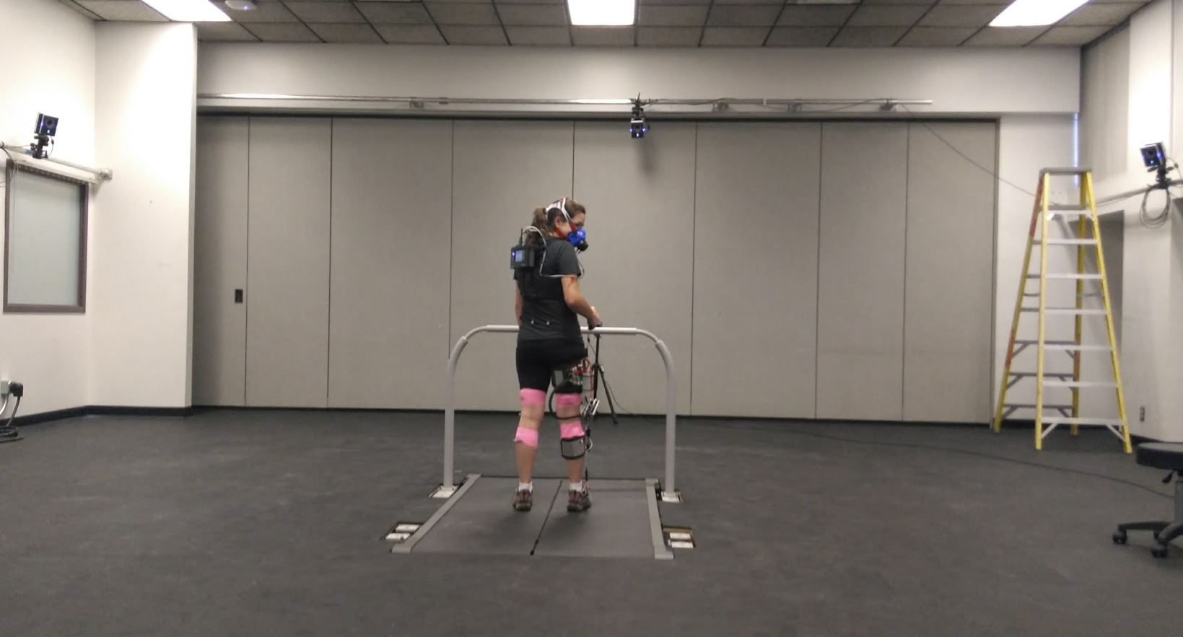
Methods
Other prototyping methods
Tested using Vicon motion capture system

Slide 9
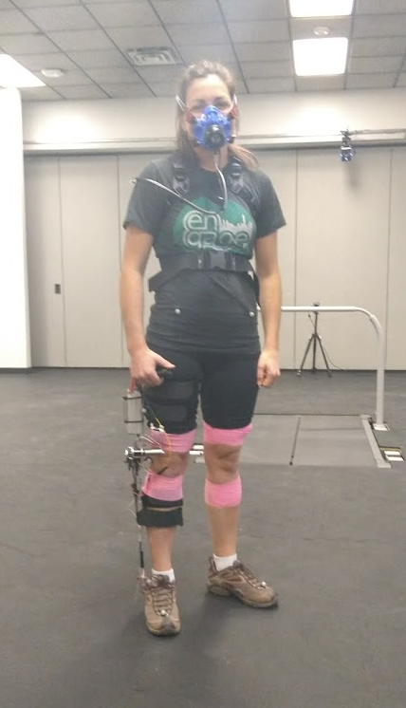
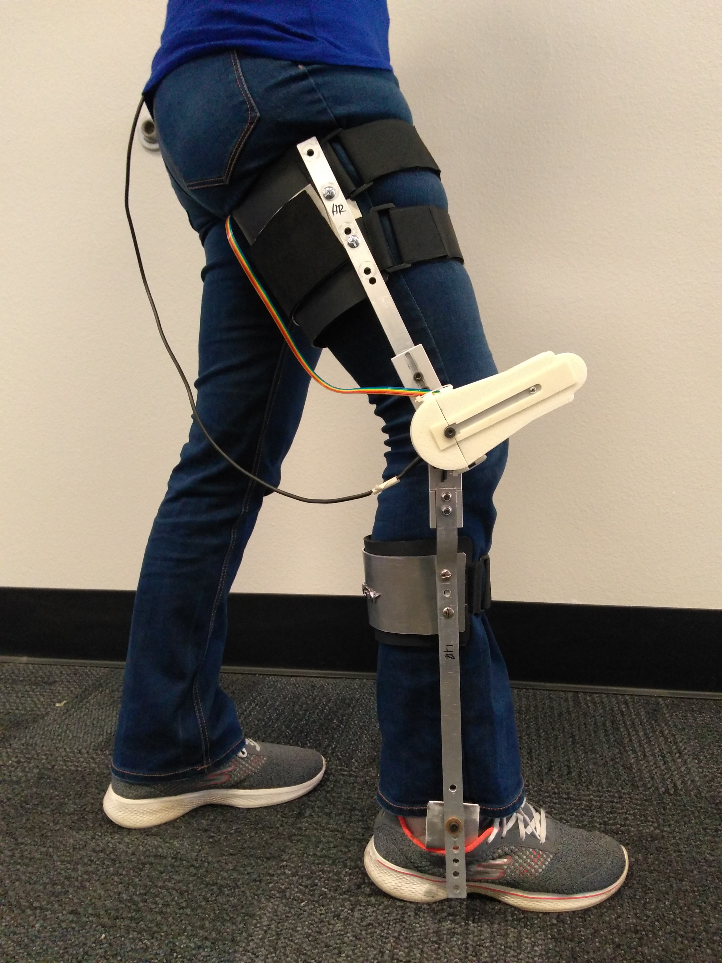
Results
Fully functioning exoskeleton
Lighter and more compact
Testing proved that the system functions as intended

Slide 10
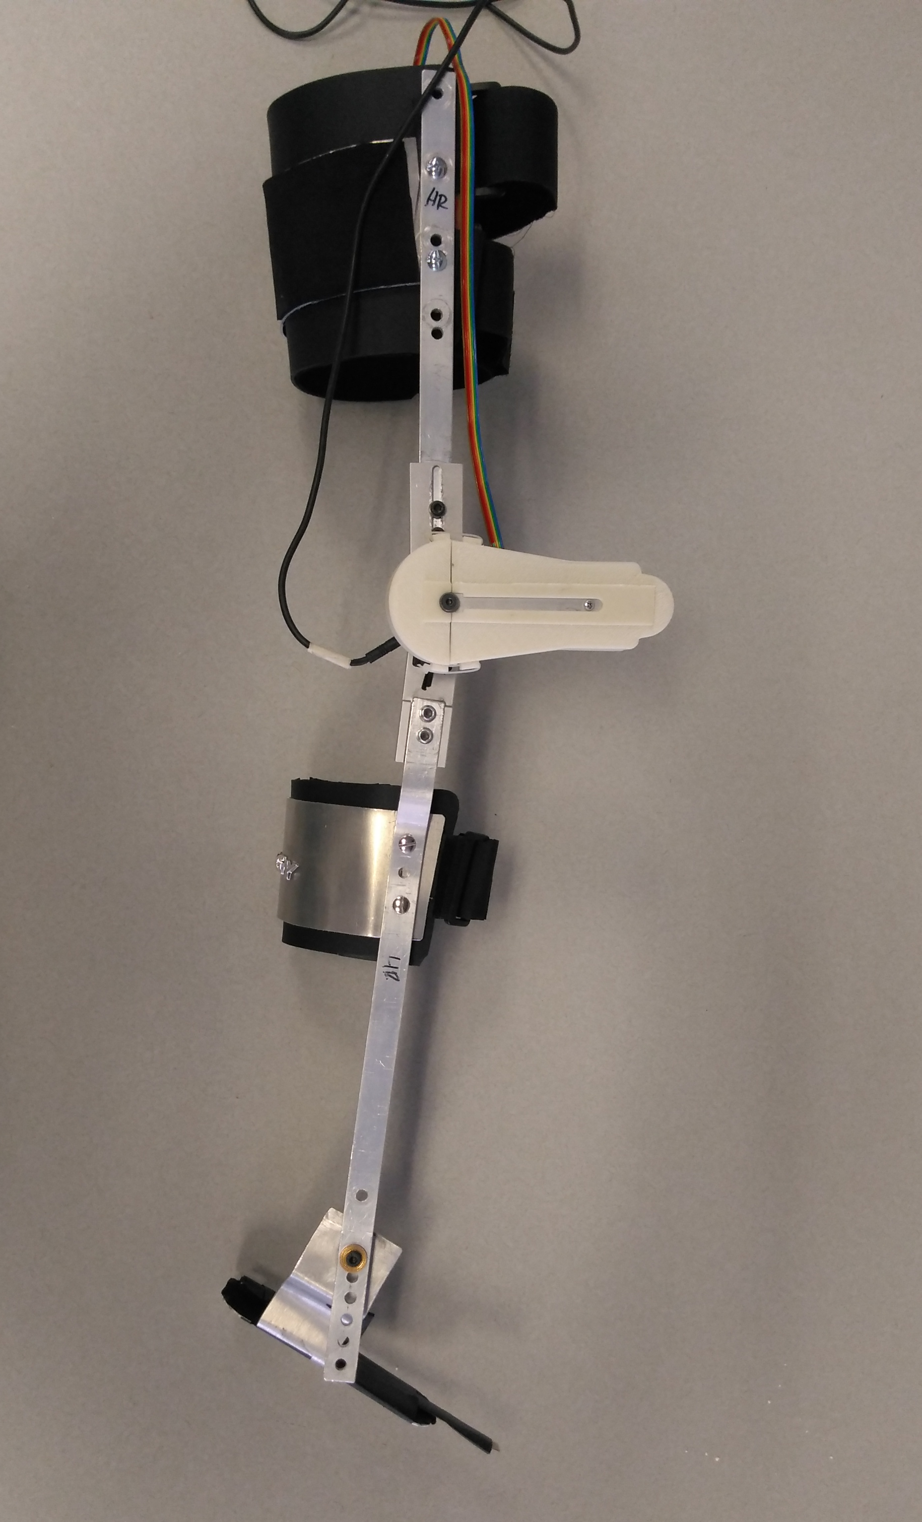
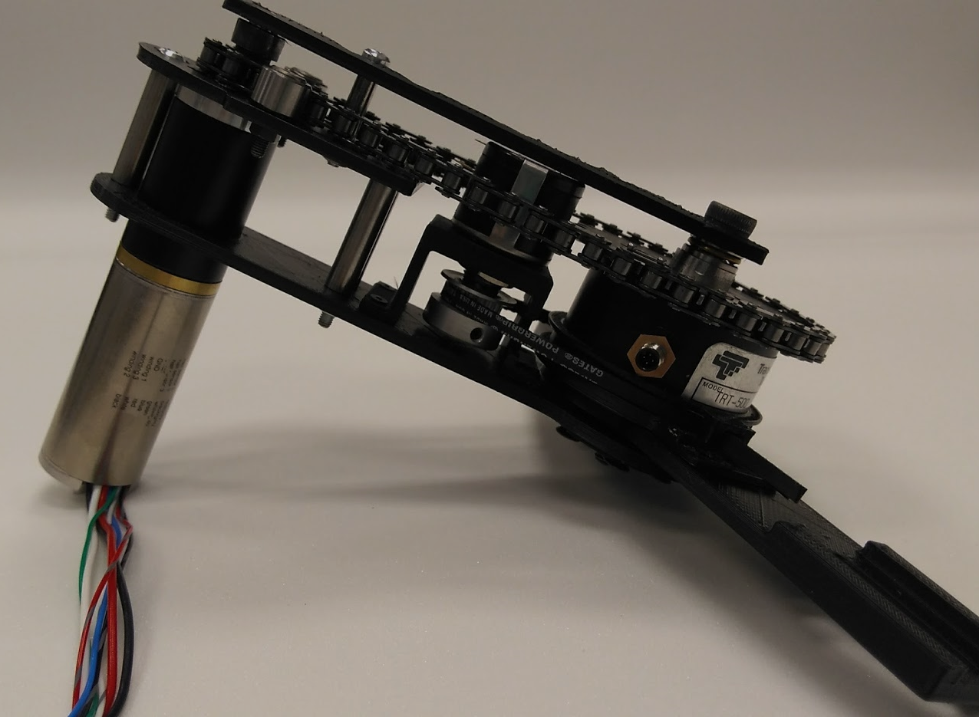
Results
Thigh Orthotic
Thigh Upright
Integrated potentiometer
Chain cover
Customizable orthotics
Motor Assembly
Chain Cover
Calf Orthotic
Calf Upright
Foot Plate
Force Sensor
Chain
Potentiometer
Motor
Torque Sensor

Slide 11
Conclusion
This system will be used in future exoskeleton studies
  Biofeedback
  Adaptive control
  Long term use
Will assist in exoskeleton development

Slide 12
Acknowledgments
Dr. Zachary Lerner
The NASA Space Grant Internship Program
Northern Arizona University

Slide 13
References
[1] A. J. Young and Daniel P. Ferris. (2017, February). “State of the Art and Future Directions for Lower Limb Robotic Exoskeletons”. [Online]. 25 (2), pp. 171-182. Available: “http://ieeexplore.ieee.org/stamp/stamp.jsp?tp=&arnumber=7393837 [March 3, 2018].
[2] D. Prindle. “Without using any power, this leg-mounted exoskeleton makes walking more efficient.” Internet: https://www.digitaltrends.com/cool-tech/leg-mounted-exoskeleton/ , April 3, 2015 [March 2, 2018].
[3] RBR Staff. “Exoskeleton Startup Cyberdyne Surges in Trading Debut.” Internet: https://www.roboticsbusinessreview.com/health- medical/exoskeleton_startup_cyberdyne_surges_in_trading_debut/ March 26, 2014 [March 5, 2018].
[4] L. Hall. “NASA's Ironman-Like Exoskeleton Could Give Astronauts, Paraplegics Improved Mobility and Strength.” https://www.nasa.gov/offices/oct/home/feature_exoskeleton.html, Aug. 7, 2017 [March 2, 2018].
[5] Z. F. Lerner et al. (2017, June). “A Robotic Exoskeleton for Treatment Of Crouch Gait in Children With Cerebral Palsy: Design and I initial Application”. [Online]. 25(6), pp. 650-659. Available: https://drive.google.com/file/d/0B5Yp2M3LufwGWHFJNDZfTUZQSDQ/view [October 9, 2017].

Slide 14
Questions?

Slide 15
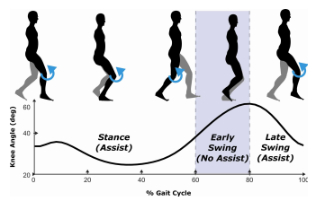
https://drive.google.com/file/d/0B5Yp2M3LufwGWHFJNDZfTUZQSDQ/view

Slide 16
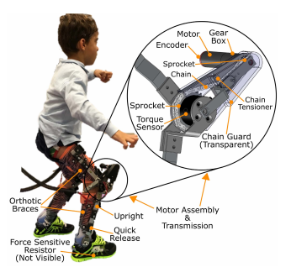
https://drive.google.com/file/d/0B5Yp2M3LufwGWHFJNDZfTUZQSDQ/view

Slide 17
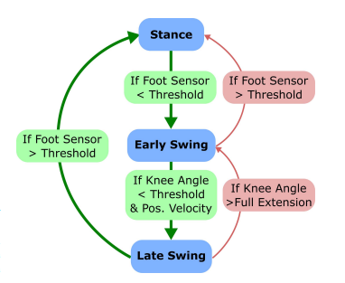
https://drive.google.com/file/d/0B5Yp2M3LufwGWHFJNDZfTUZQSDQ/view

